Slide 1



SIVYX – UNIX Based OS DEMO
OS Demo showing file and
process subsystem features
Div-D Group id-82 Date-21.08.2004
Presented by: Project Guide:
Vipra – 12210194 Dr. Sheetal Phatangare
Ishaan Yadav – 12210302
Shriraj Yamkanmardi – 12210596
Yash Maheshwari - 12211472

Slide 2
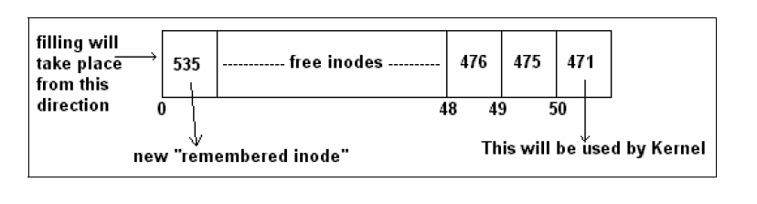
Why sivyx ?
Operating System is such a subject that seems to be easy when it is learned first time. But as we go deeper and deeper inside it, we get to know that this thing also have many tricks and errors hidden it, but due to our overlooking they are getting ignored
Difficulty with OS like UNIX is that their basic structure is also so much complex due to which finding flaws (which are really present)and correcting them with maintaining all the compatibility of system is very challenging

Slide 3
S.NO | TITLE | AUTHORS | ABSTRACT
1. | The UNIX Time Sharing System | Dennis M. Ritchie and Ken Thompson Bell Laboratories | UNIX is a general-purpose, multi-user, interactive operating system for the Digital Equipment Corpora tion PDP-11/40 and 11/45 computers. It offers a number of features seldom found even in larger operating sys tems, including: (1) a hierarchical file system incorpo rating demountable volumes; (2) compatible file, device, and inter-process I/O; (3) the ability to initiate asynchro nous processes; (4) system command language select able on a per-user basis; and (5) over 100 subsystems including a dozen languages. This paper discusses the nature and implementation of the file system and of the user command interface.
2. | AFast File System for UNIX* | Marshall Kirk McKusick, William N. Joy†, Samuel J. Leffler‡, Robert S. Fabry | A reimplementation of the UNIX file system is described which provides substantially higher throughput rates by using more flexible allocation policies. The new file system clusters data that is sequentially accessed and provides two block sizes to allow fast access to large files while not wasting large amounts of space for small files. File access rates of up to ten times faster than the traditional UNIX file system are experienced.

Slide 4
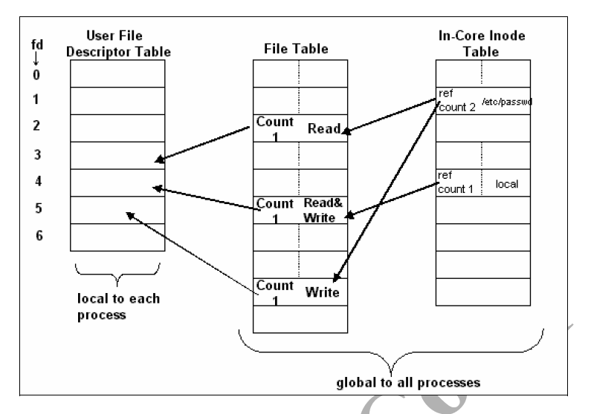
Goals to achieve
To implement and understand some features of UNIX FS(File Subsystem) and UNIX PS (Process Subsystem) and elaborate them neatly in project
Adding some self features into SIVYX like
actual tree like file system to the OS
Keeping one address of buffer throughout the memory for accessing
Memory management at some extent
If possible, handling process by self control without much involvement of kernel

Slide 5
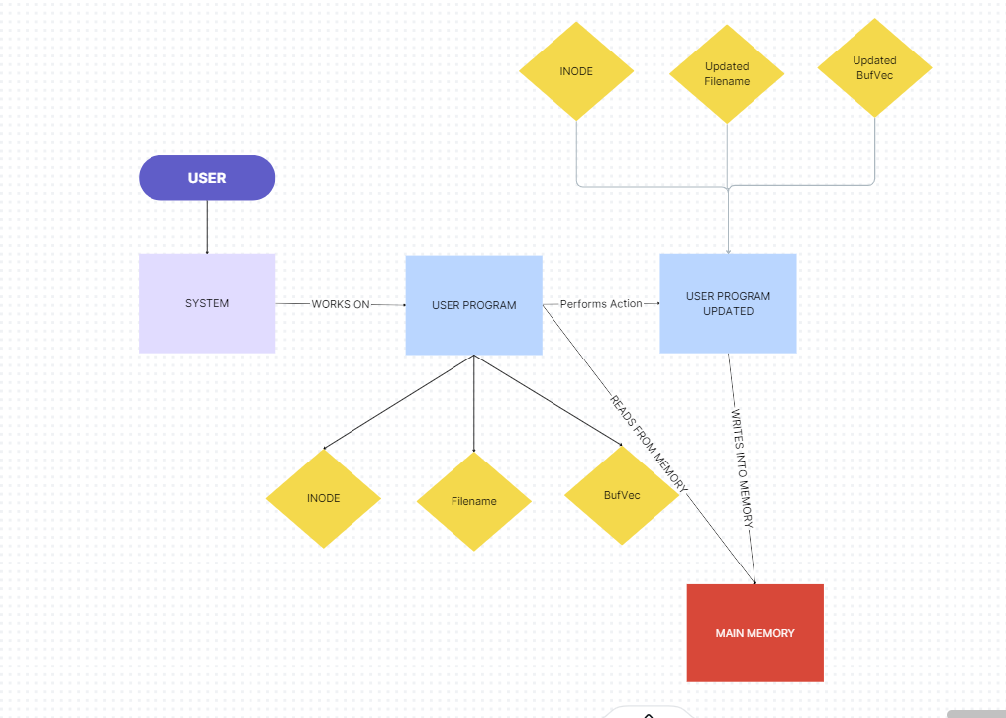
WORKFLOW OF SYSTEM

Slide 6

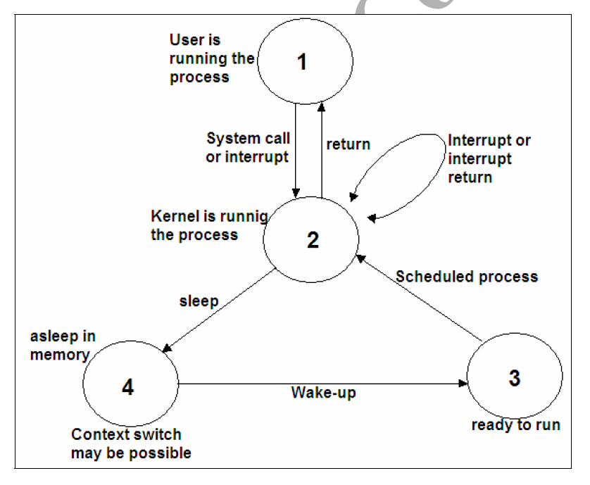
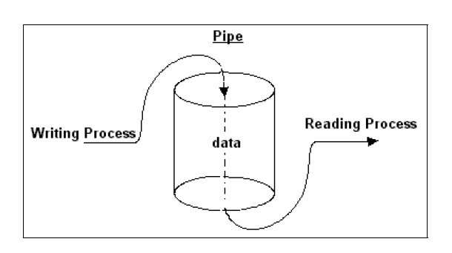
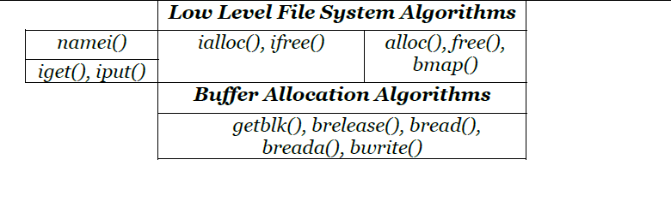
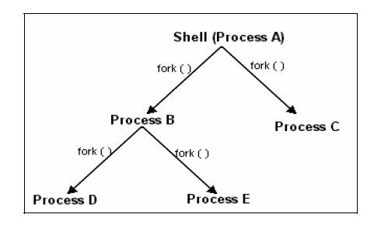
Main components
FILE
PROCESS
INODE
BUFFER

Slide 7
METHODOLOGY
Buffer
Inode
Buffer Number
Buffer Space
Inode Number
Corresponding File
Main Memory
Files
IVT
BT
BufVEc
FILE
Corresponding Buffers
Corresponding File
BufVec
INODE

Slide 8
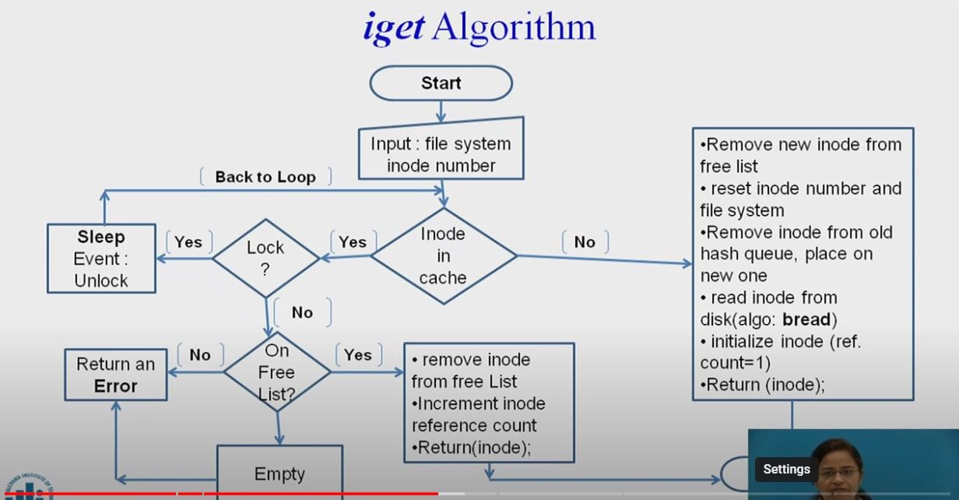
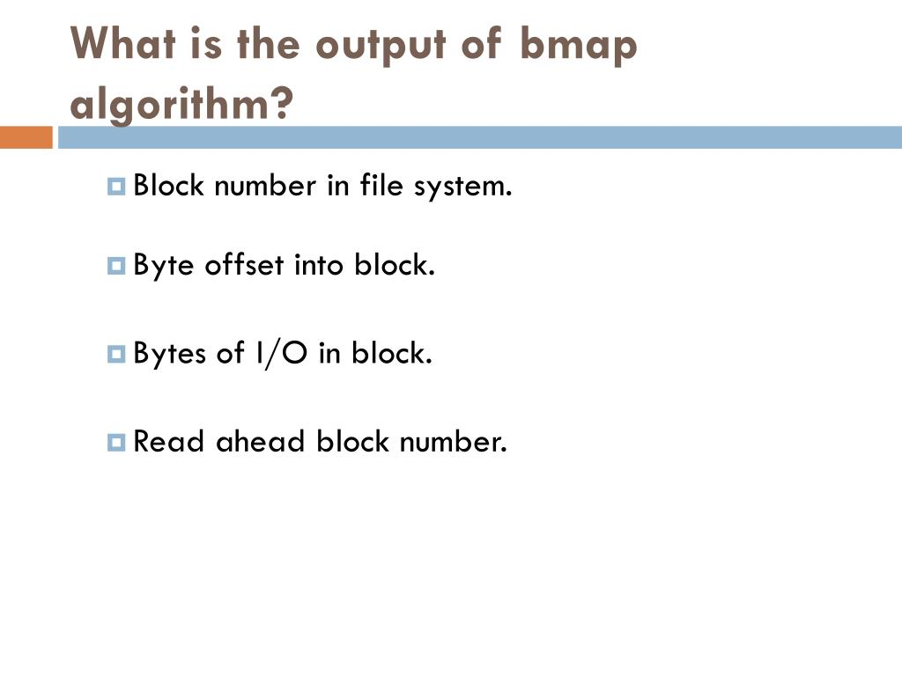
Algorithms Explained
iget
(Inode Get Algorithm)
bmap
(Buffer Mapping Algorithm)

Slide 9
Contribution to Project
Vipra
Ishaan
Shriraj
YAsh
Learning UNIX File System and Designing it’s structure
Designing Main Memory Strcuture
Documentation of Project
Learning Buffer and Inode structure deeply and generating it’s coding structure according to OOP
Helping in Coding of File System and Process System
Learning Process subsystem based on FS and finding some new structure for it
Designing File Storing structure for the project
Implementing code for both File System and Process System
Implementing code for new ideas according to suggestions of group members and guide

Slide 10
TOOLS and Appliances used
Help Taken From
Design of UNIX System :- Maurice J. Bach
Magic Garden
Astromedicomp Notes :- Dr. Vijay D. Gokhale
Software Requirements
C++ (At least 2011 Version)

Slide 11
implementation
Buffer
INODE
File
Structure of Buffer
Free List of Buffers (Class)
Add Buffer
Allocate Buffer
Show List
Buffer Pool (Class)
Create Buffer
Add Buffers To Free List
WriteToBuffer (Function)
BufVec (Class)
Insert Buffer
WriteToBuffer
ClearBufVec
CopyBufVec
LinkBufVec
Structure of Inode
Free List of Inodes (Class)
Add Inode
Allocate Inode
Show List
Inode Pool
Create Inode
Add Inodes to Free List
Files (Class)
ShowInfo
Write
DisplayContent
showInode
showBuffers
Clear
Copy
Link

